Slide 1
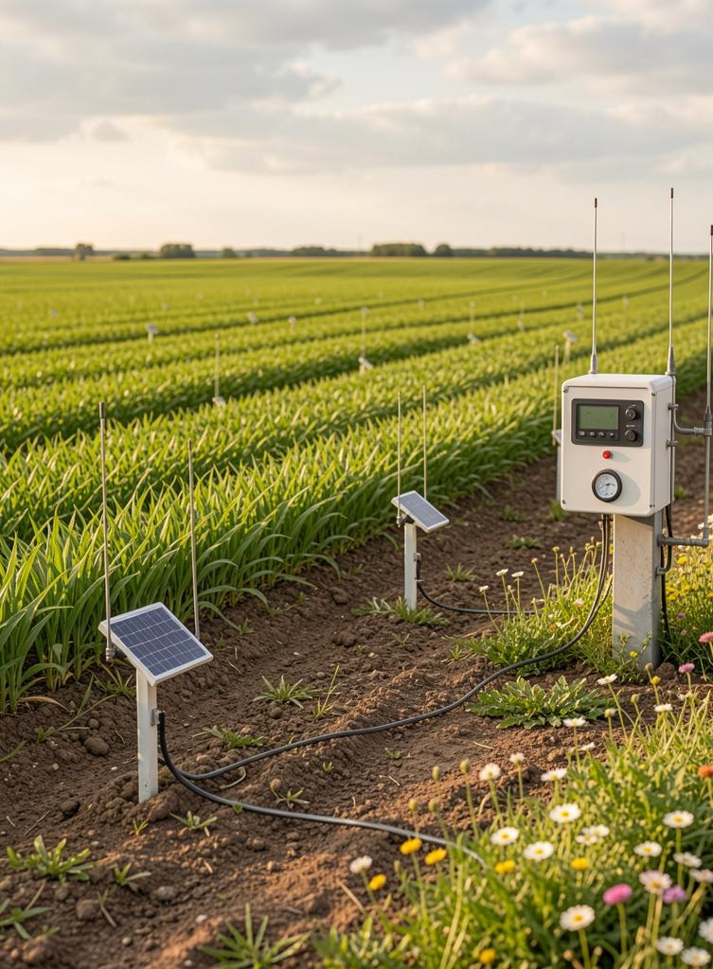

Climate Resilience & Smart Geography
Summer Malik | Ayemehenre Isikhuemhen | Elijah James

Slide 2
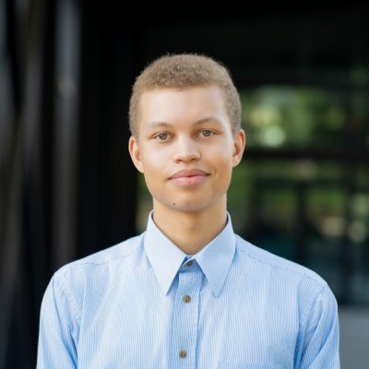
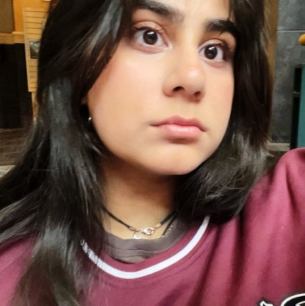
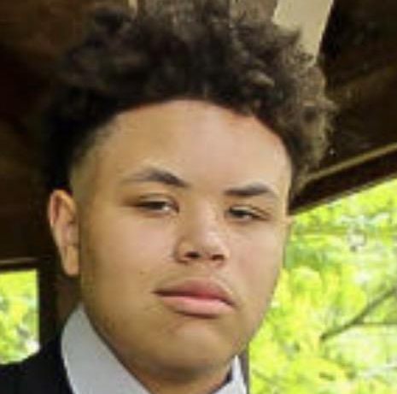
Meet Our Team
Ayemhenre Isikhuemhen
Major: Computer Science
Summer Malik
Major: Computer Science and Biology
Elijah James
Major: Computer Science
CO-LAB Pitch Competition 2026
AgriZone

Slide 3
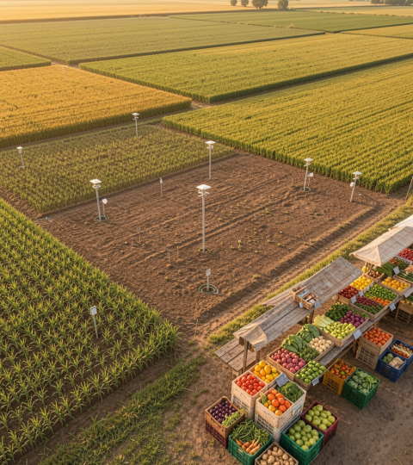
01
The Problem

Slide 4
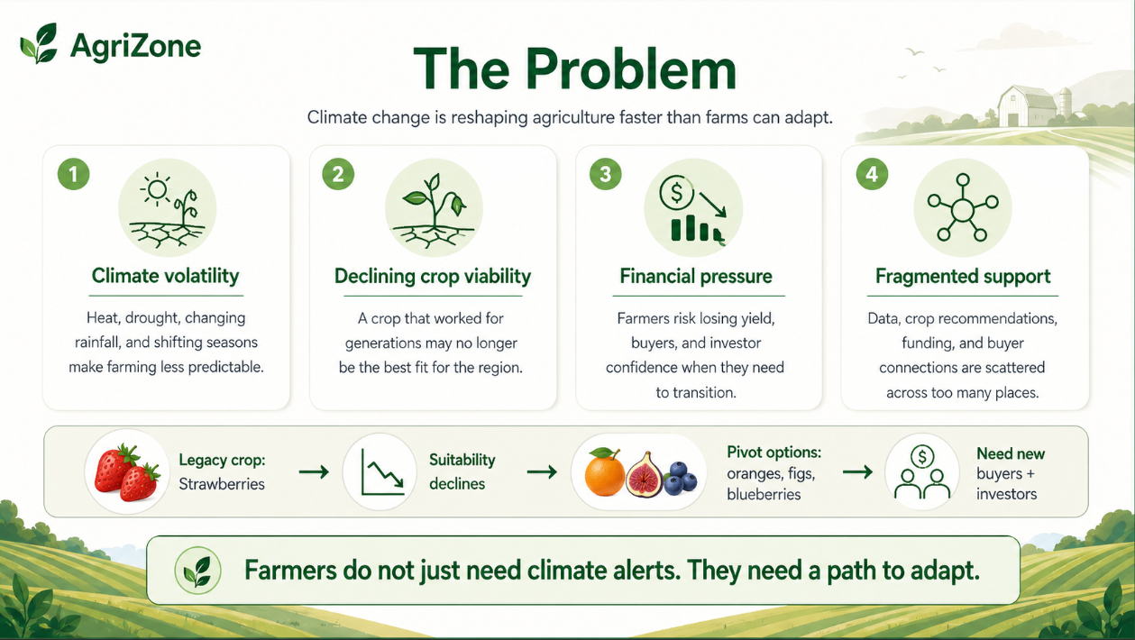

Slide 5
02
The Solution

Slide 6
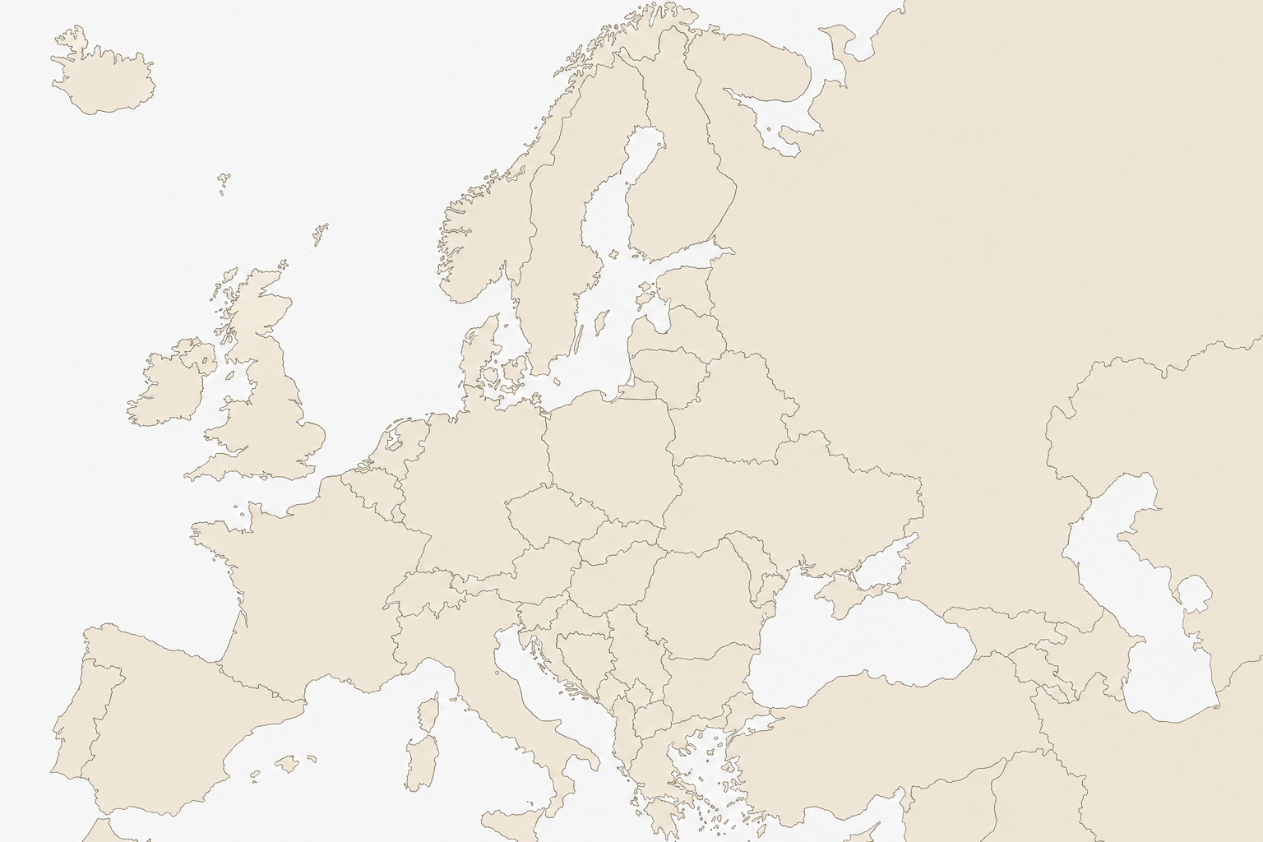

The Solution
CO-LAB Pitch Competition 2026
AgriZone
The horticulture industry needs a pivot against climate change.
Farmers
Investors / shareholders
Supply Chains
There a need to get ahead on suppliers and logistics for providing produce.
Such large scale and complex coordination needs a unifying platform.
🍇
🍊
🚜
Notes:
Changed slide 5

Slide 7
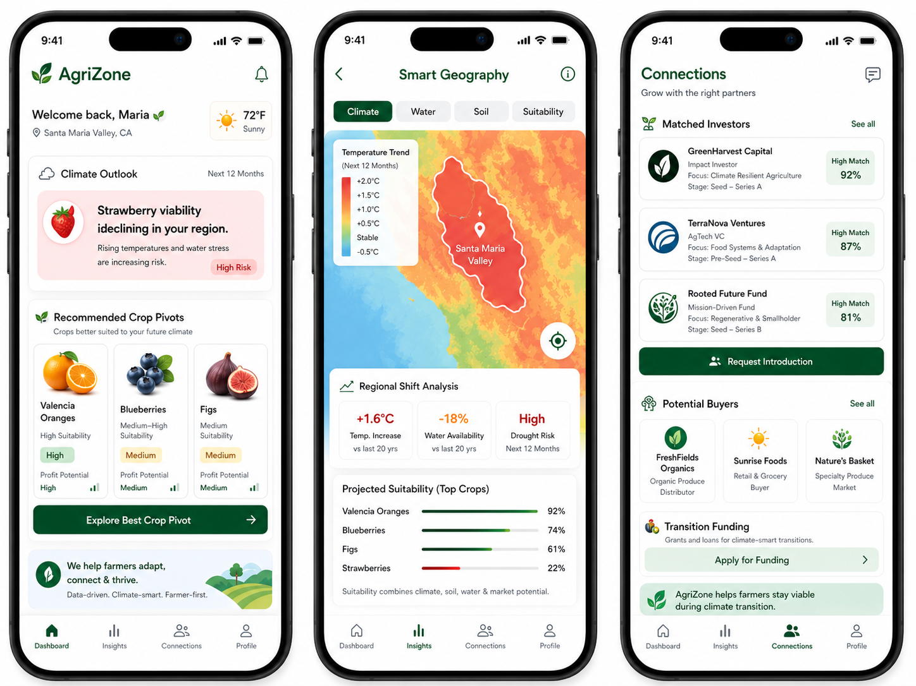
Notes:
Change on slide 7

Slide 8
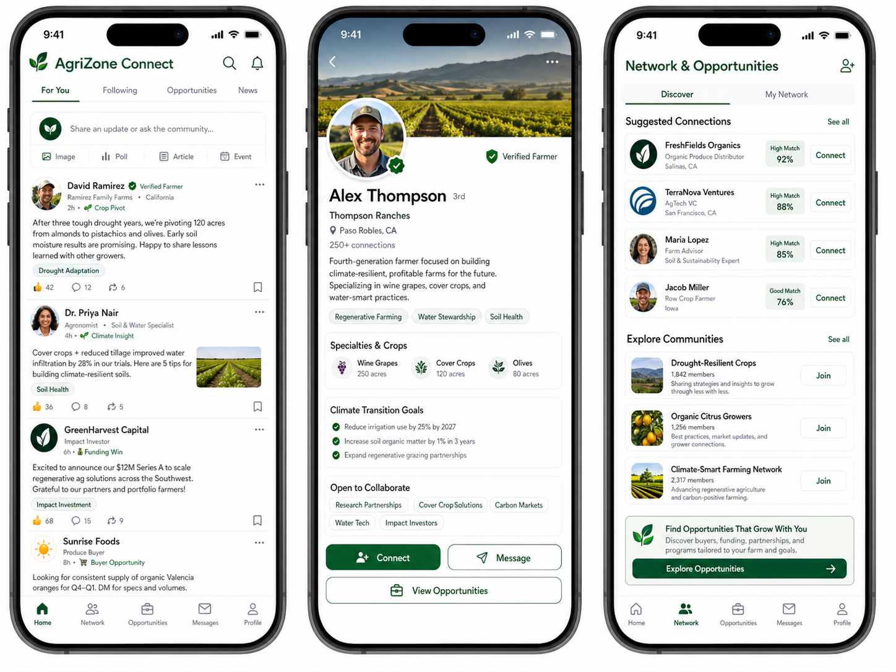

Slide 9
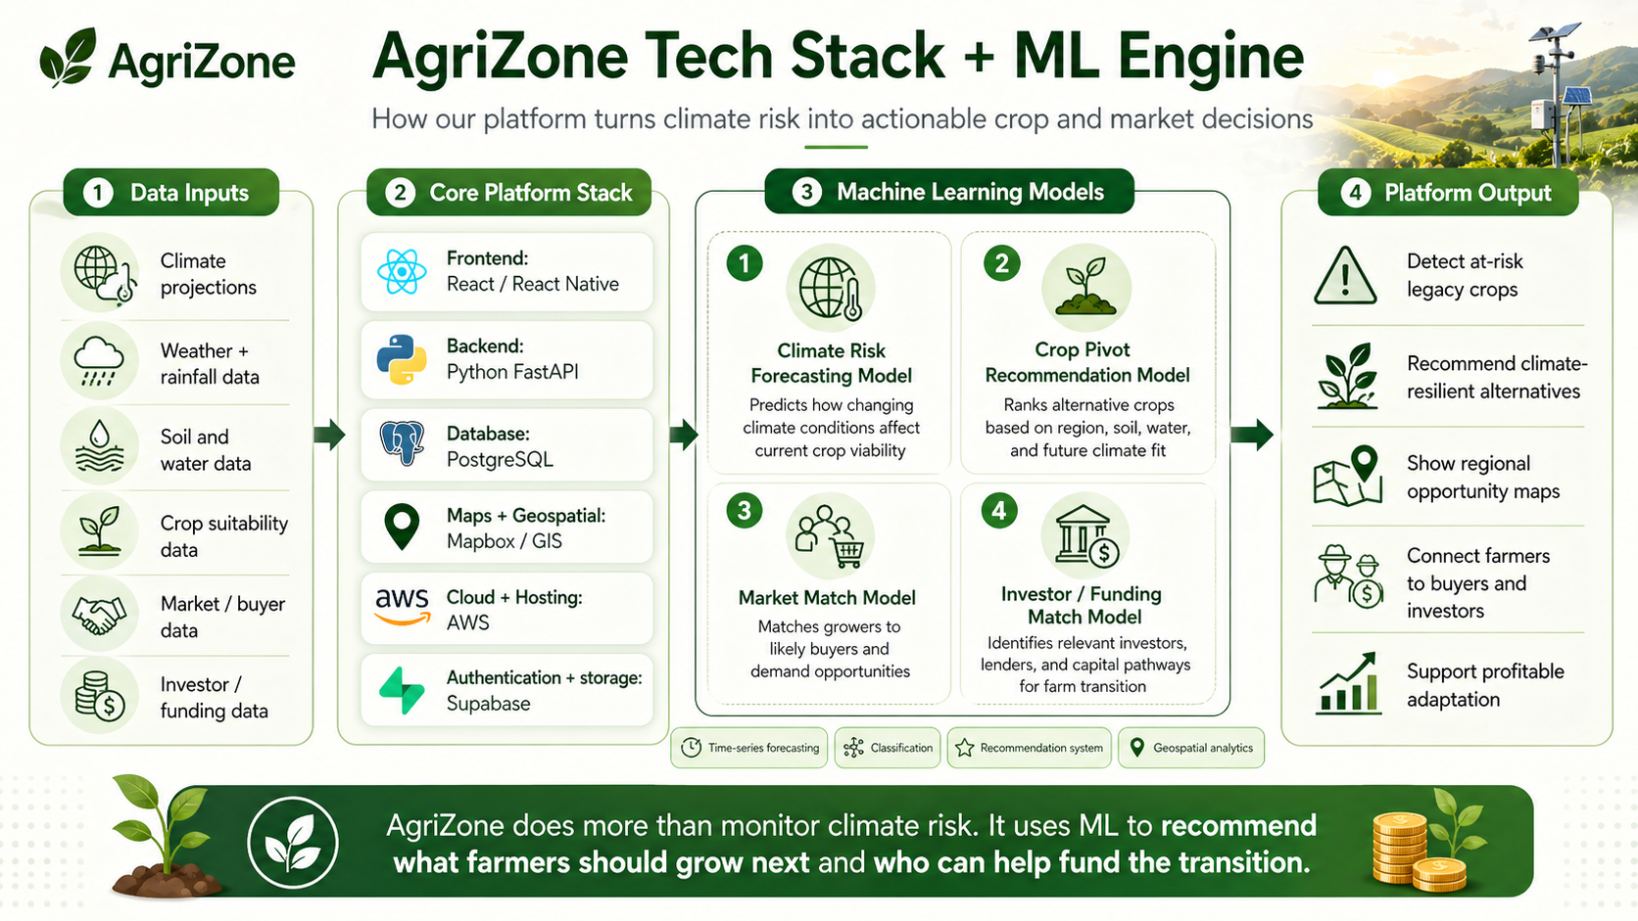

Slide 10
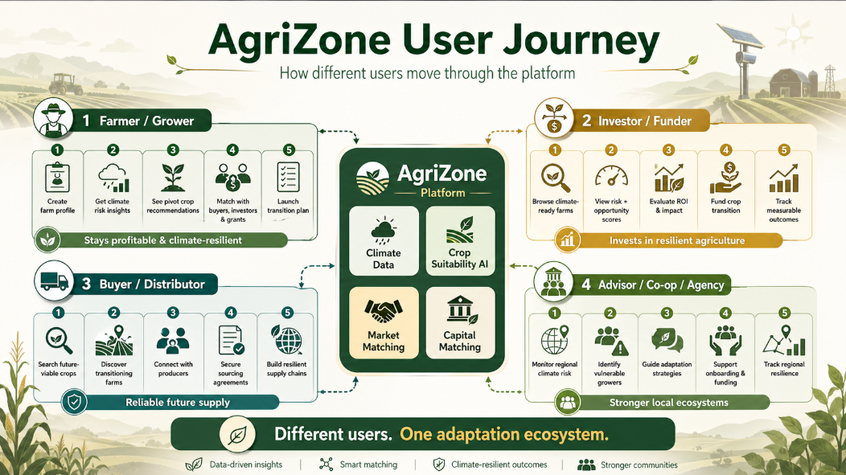
Notes:
Added slide 9

Slide 11
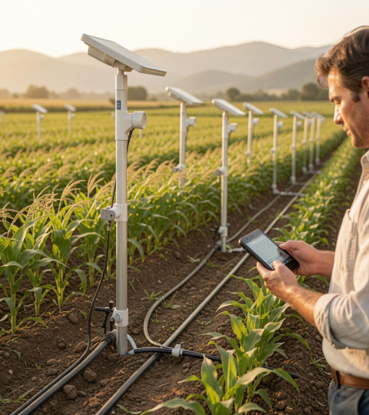
03
Product Roadmap

Slide 12
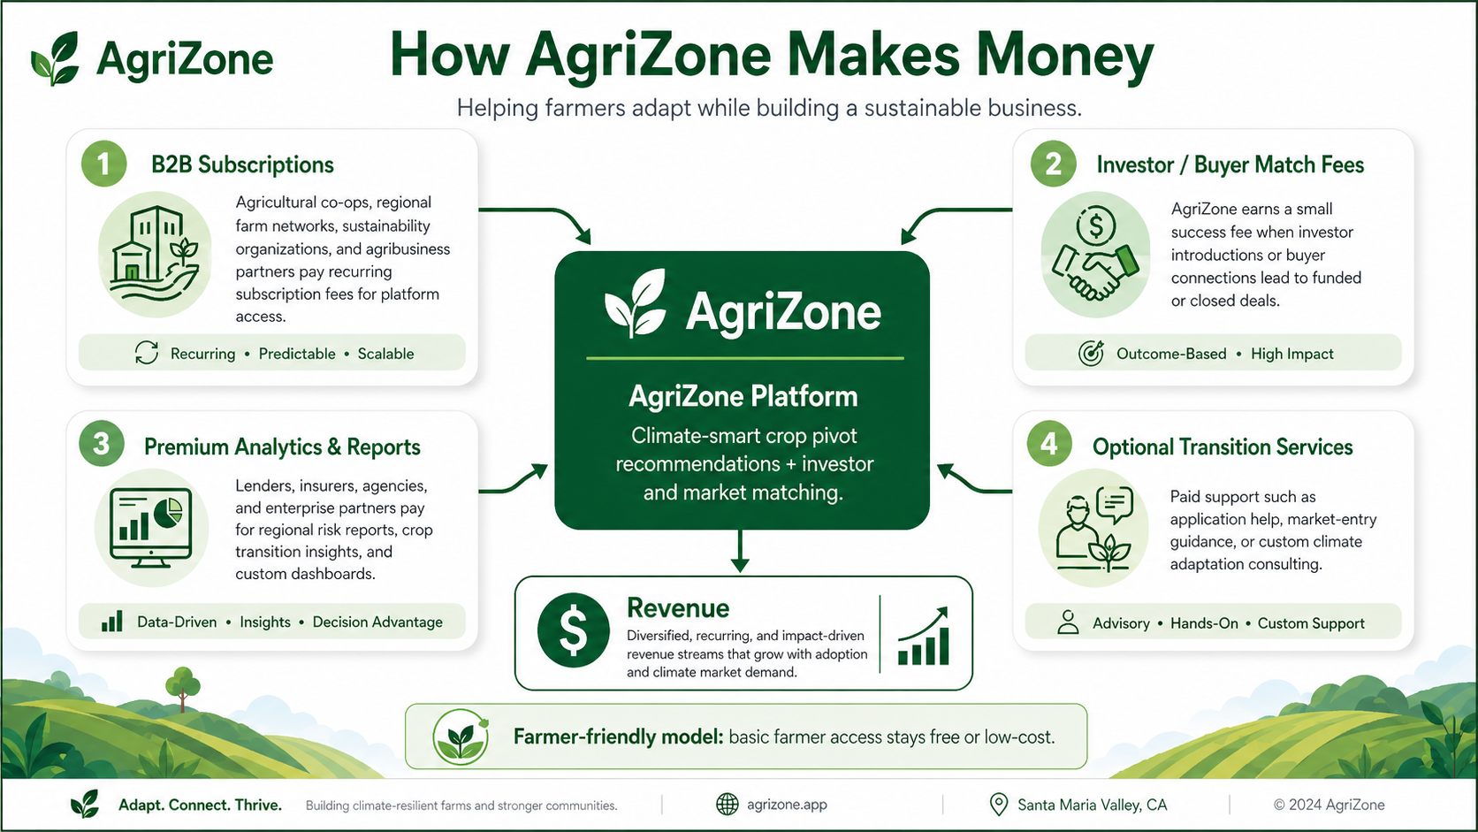
Notes:
Change on slides 10

Slide 13
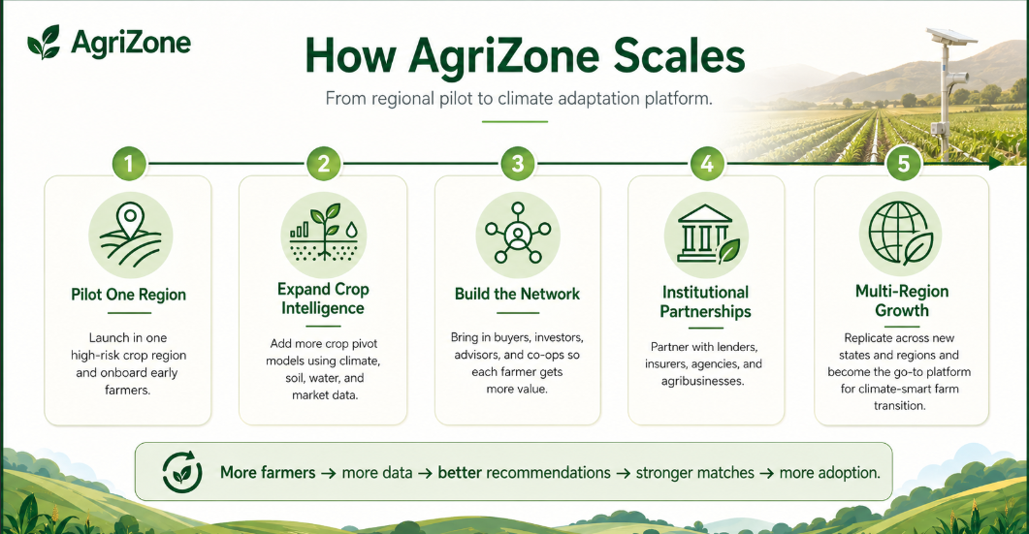

Slide 14
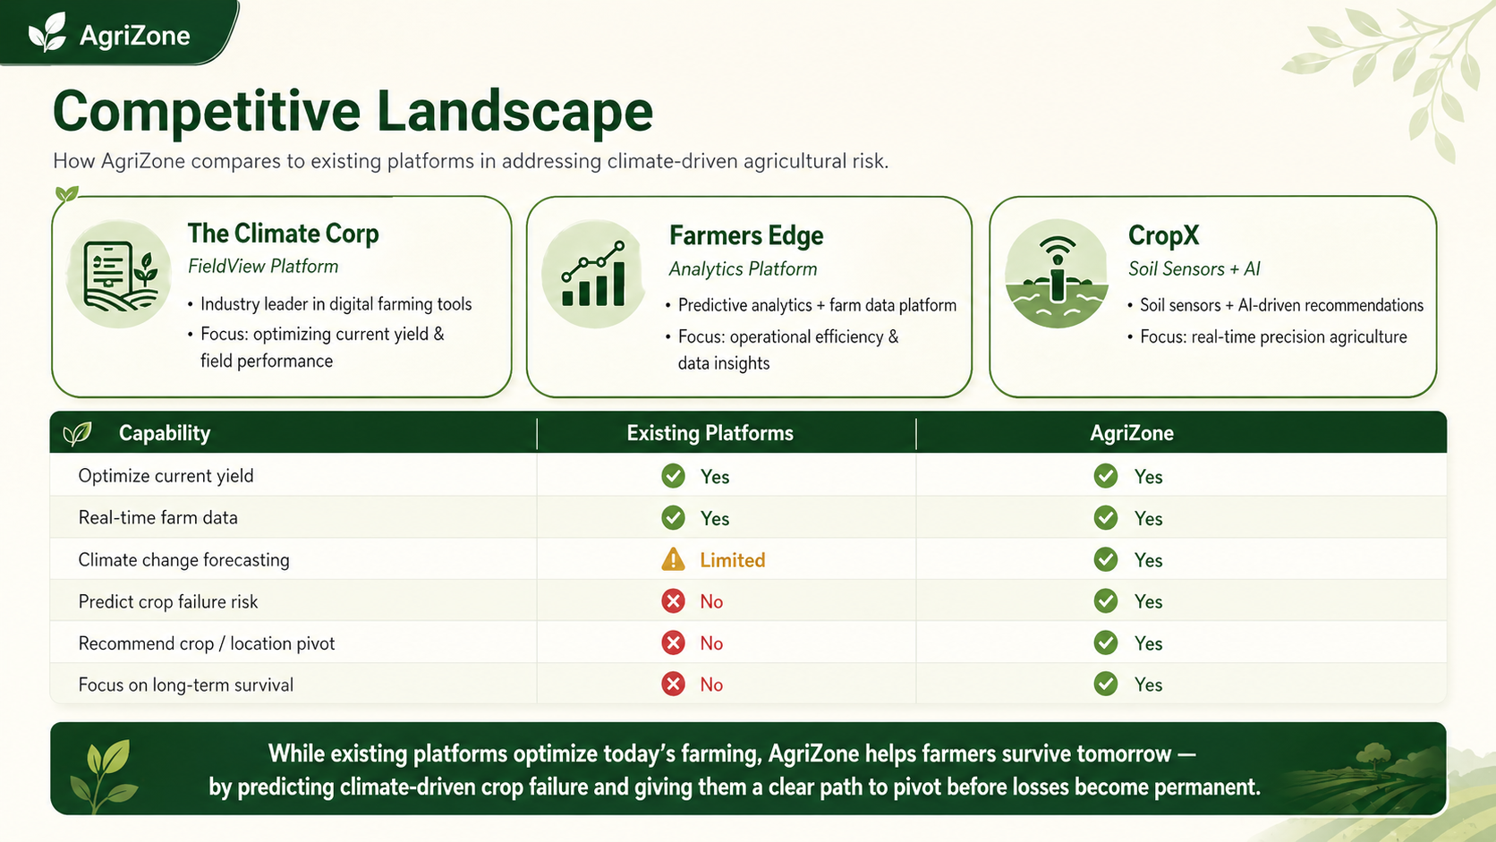
Competitors

Slide 15

Product Impact
How do we realistically expect our product to impact the tech/horticulture industry.

Slide 16
Thank You!
CO-LAB Pitch Competition 2026
AgriZone
The future of food is coordinated, resilient, and it starts here with AgriZone.
Please feel free to share your questions

